Slide 1
CS 4900 Project
Group: 6
Michael Hayes
Ryan Slaybaugh
Semira Pinder

Slide 2
What type of game are we making?
First-person action-adventure platformer
First-person: Any game that has a camera set and locked in the First Person view.
Action-Adventure: A game with core elements from both action and adventure based games.
Platformer: A game where the player must traverse multiple platforms to complete the game.

Slide 3
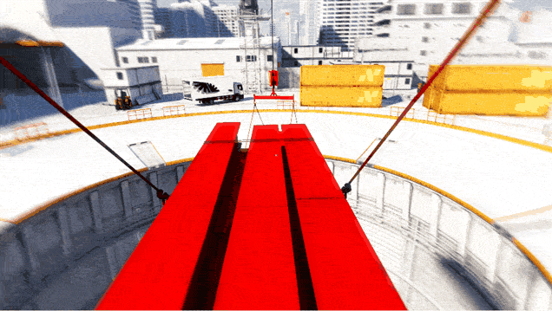
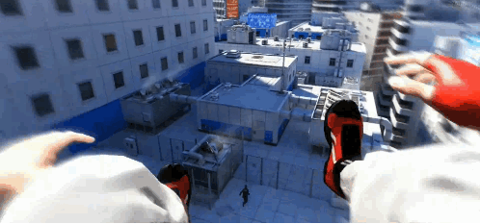
Mirror’s Edge

Slide 4
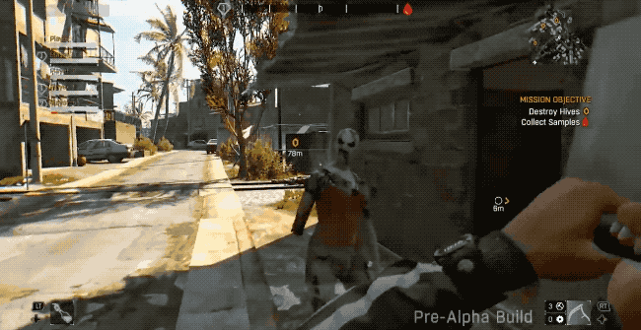

Dying Light

Slide 5
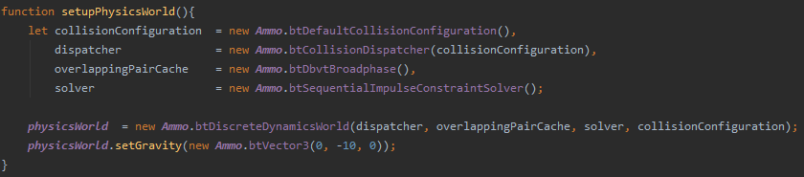
Physics
Ammo.js Library
Direct port of the Bullet physics engine to JavaScript using Emscripten.
Automatically takes care of the logic within the physics realm.

Slide 6
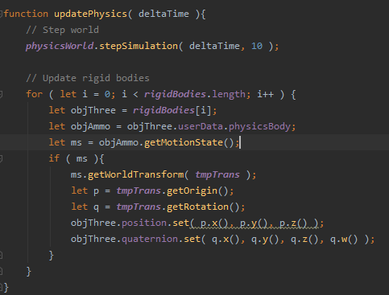
Movement
Movement must be handled for both the graphical and physic plane.
Event Handlers are used to take key input and move the player object.

Slide 7
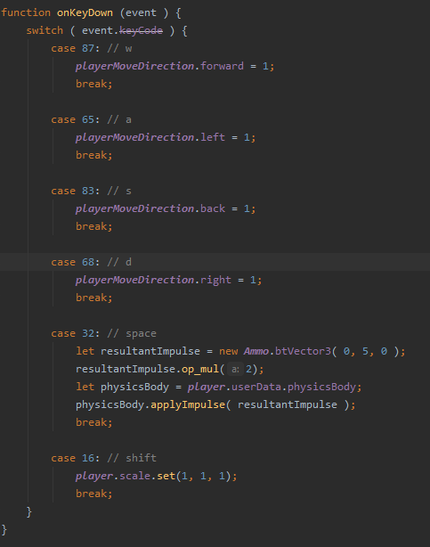
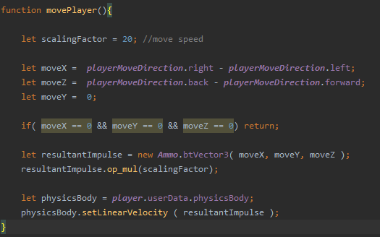
Key codes are used to know what key is pressed.
Array value changes based on directional key.
Linear velocity of the player physics body is set to the direction of the key pressed.

Slide 8
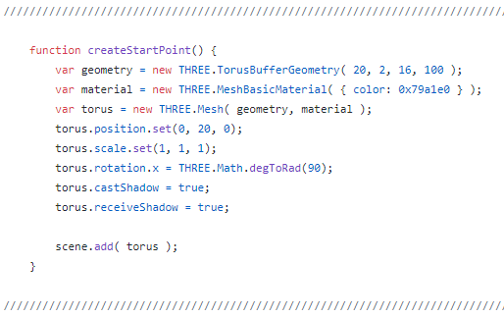
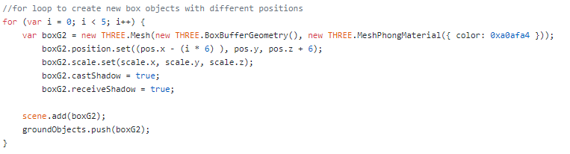
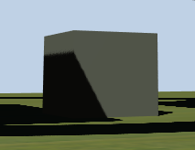
Object Creation
Three.js allows for several basic 3d objects
Simple Object Creation made easy
For loop iteration of objects possible
Separation of main.js and gamestage.js

Slide 9
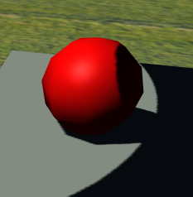
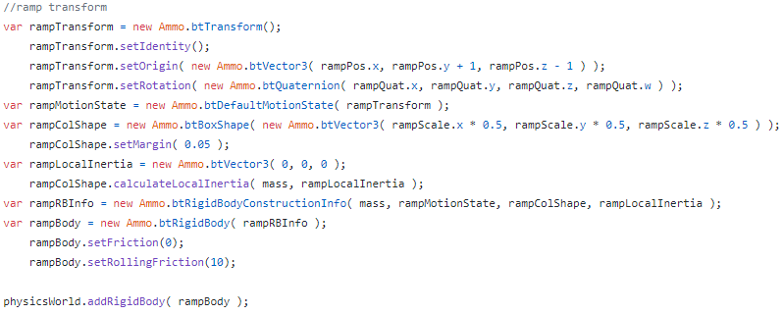
Simple Object Collision
Applying a collision body to the main body
Several types of collision bodies
https://pybullet.org/Bullet/BulletFull/index.html

Slide 10
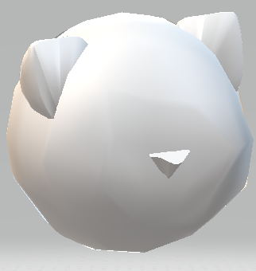
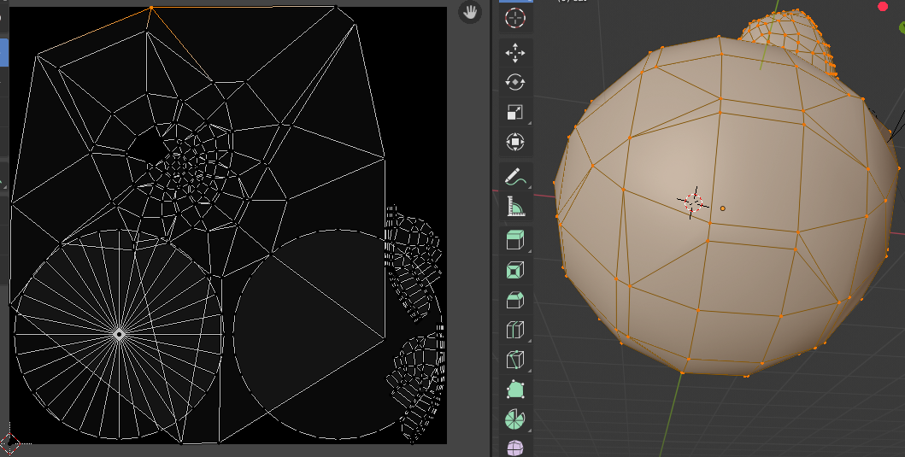
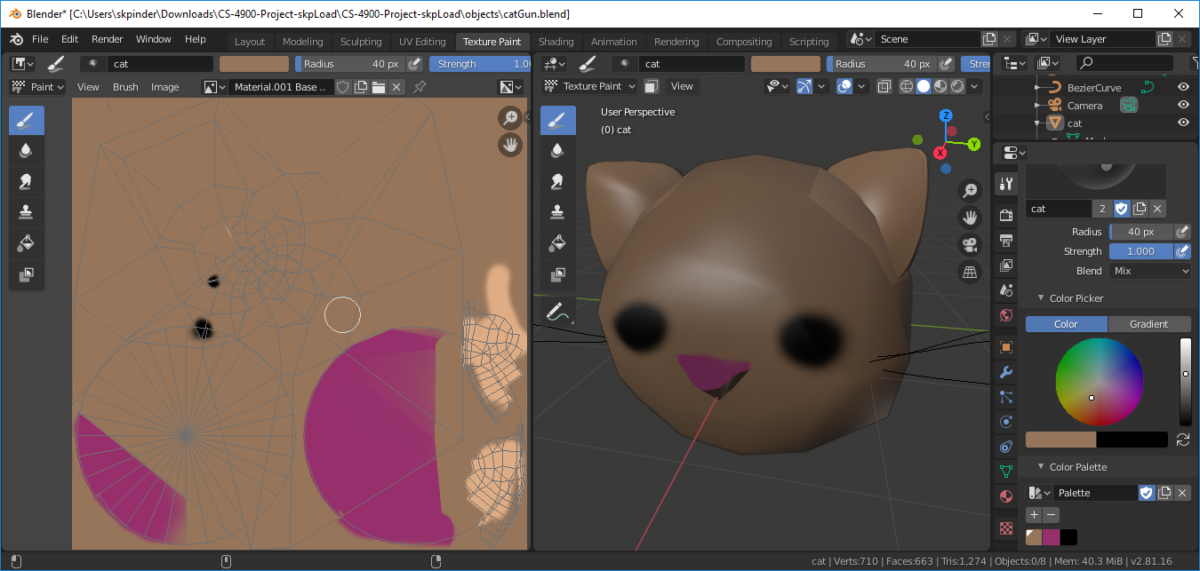
Blender
Shape manipulation
UV Editing
Texture Painting
Notes:
Sculpted shapes out of the base shapes, then turned to mesh and combined, then sculpted further
UV Editing- selecting the vertices you want then mapping it to a UV map so the program can use the texture image
Texture Paint - Painting the texture map, updates in real time

Slide 11
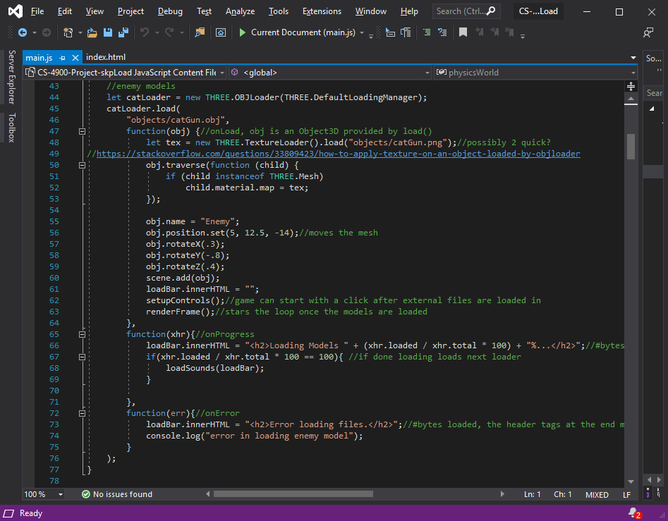
Loaders
Asynchronous loading control
OBJLoader
HTML header manipulation
Model not in right places
Notes:
Helps with asynchronous environment since the game loop doesn’t start without loading the model and sound first,
Had to copy the OBJLoader in from a git repository for some reason, but the link’s in the OBJLoader page with threejs. Had a commit yesterday so they may be working on it.
Changed the HTML headers by their id’s for stages in the loading process

